Slide 1
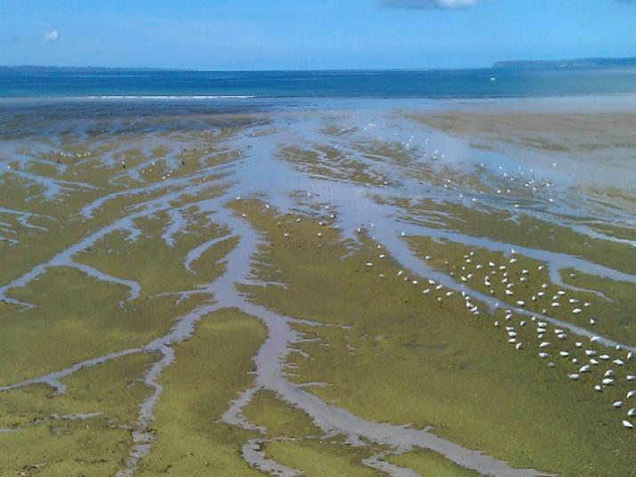
Visualising spatial data for ESV using GIS
Charly Griffiths (MBA)

Slide 2
What is GIS?
A geographic information system (GIS) integrates hardware, software, and data for capturing, managing, analyzing, and displaying all forms of geographically referenced information.
GIS allows us to view, understand, question, interpret, and visualize data in many ways that reveal relationships, patterns, and trends in the form of maps, globes, reports, and charts.

Slide 3
What is GIS used for?
Understand WHERE things are
Understand QUANTITIES
Understand DENSITIES
Find what’s INSIDE
Find what’s NEARBY
Understand CHANGE
GIS is part of the process not merely the end result – “a pretty map”
Notes:
Where things are: mapping where things are lets you find places that have the features you’re looking for and to see patterns.
Map quantities: to find places that meet their criteria and take action (e.g. children's clothing company might want to find post codes with many young families with relatively high income)
Map densities: a density map lets you measure the number of features using a uniform areal unit so you can clearly see the distribution
Find what’s inside: monitor what’s happening and take specific action by mapping what’s inside a specific area.
Find what’s nearby: what’s occurring within a set distance of a feature by mapping what’s nearby
Map change: map the change in an area to anticipate future conditions, decide on a course of action, or to evaluate the results of an action or policy. By mapping where and how things move over a period of time, you can gain insight into how they behave.

Slide 4
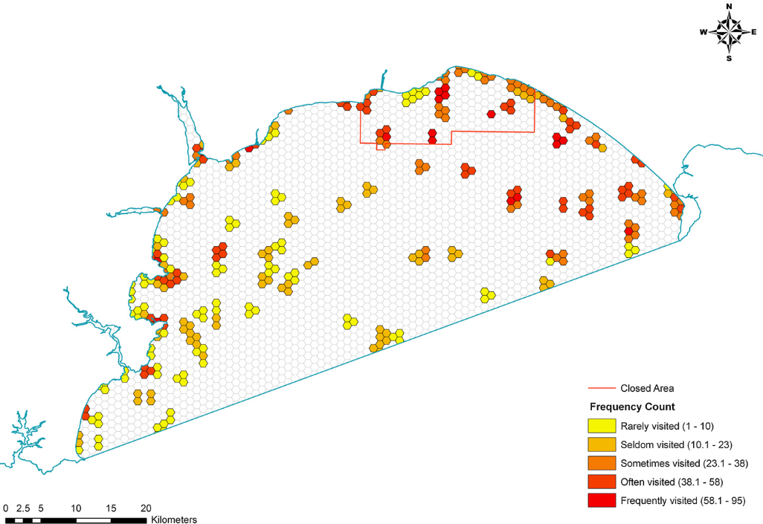
Examples of Outputs
Siân E. Rees, Martin J. Attrill, Melanie C. Austen, Stephen C. Mangi, Lynda D. Rodwell, A thematic cost-benefit analysis of a marine protected area, Journal of Environmental Management, Volume 114, 15 January 2013, Pages 476-485

Slide 5
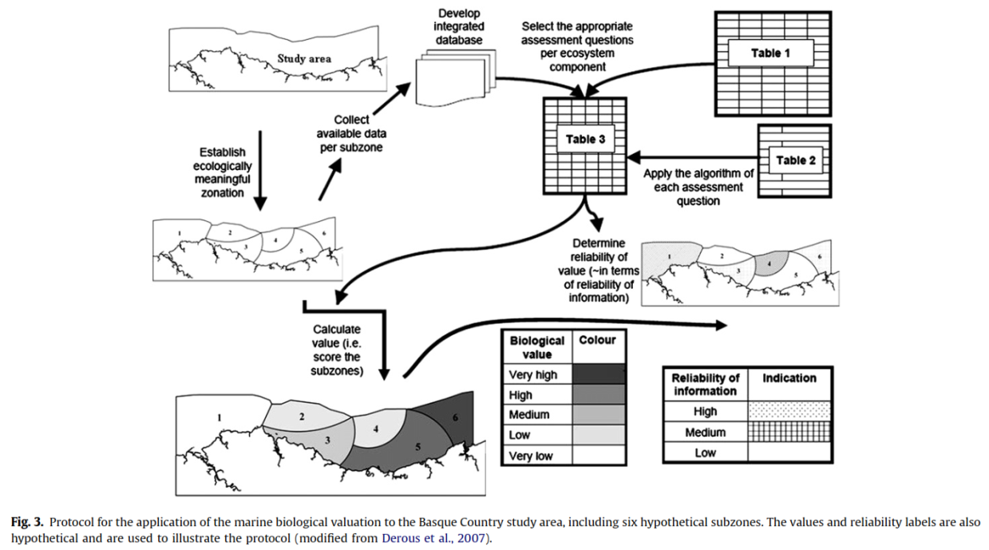
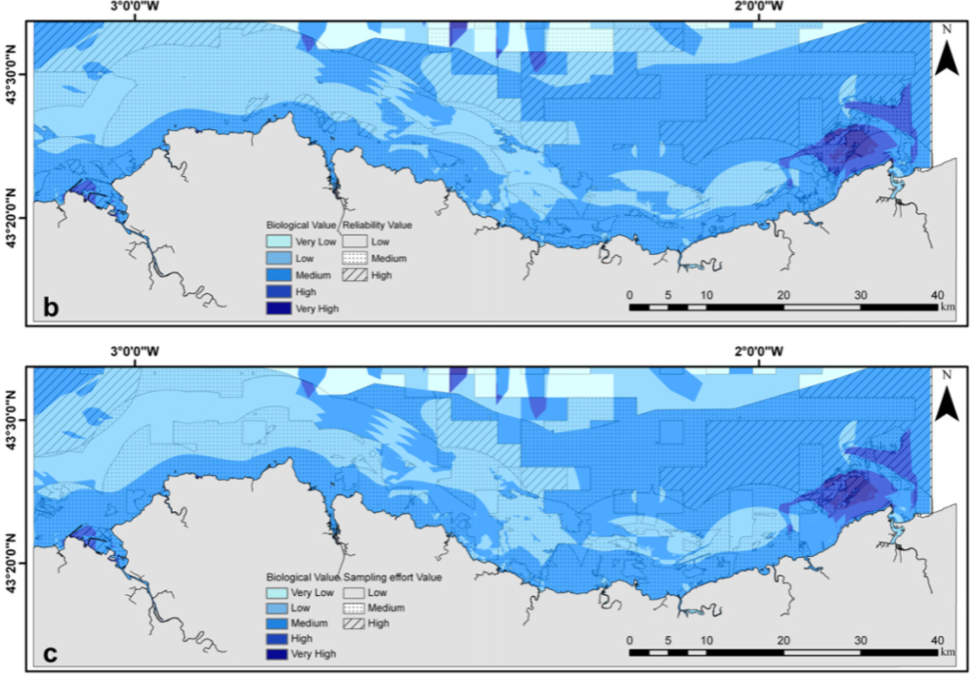
Examples of Outputs
Pascual,M; Borja,A; Vanden Eede,S; Deneudt,K; Vincx,M; Galparsoro,I; Legorburu,I; 2011. Marine biological valuation mapping of the Basque continental shelf (Bay of Biscay), within the context of marine spatial planning, Estuarine, Coastal and Shelf Science, Volume 95, Issue 1, Pages 186-198
Notes:
This paper presents the Biological Valuation Map for the Basque continental shelf and estuaries. A BVM aims to include all available biological and ecological information for a selected study area, allocating an integrated intrinsic biological value to the subzones within the study area. In this case all biological data available from 2003 to 2011 was used: zooplankton, macroalgae, macrobenthos, demersal ﬁsh, seabirds and cetaceans. You can see from this map that the subzones are of unequal sizes and will no doubt have varying amounts of data and survey effort. In order to avoid bias across these subzones, Relability and Sampling effort were attached to each of the Biological Values which display the quality and amount of data used to assess Biological Value in each area.

Slide 6
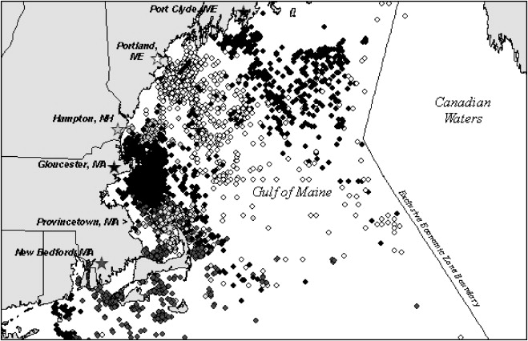
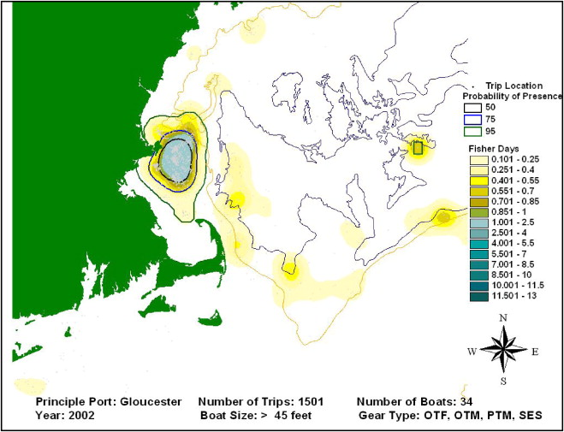
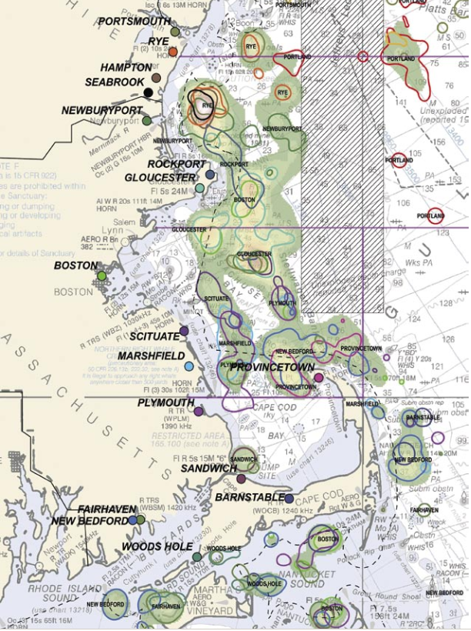
Examples of Outputs
Kevin St. Martin, Madeleine Hall-Arber, The missing layer: Geo-technologies, communities, and implications for marine spatial planning, Marine Policy, Volume 32, Issue 5, September 2008, Pages 779-786.
Notes:
This is a really lovely study that looks into a participatory method to map the presence of fishing communities at sea in the Gulf of Maine. Here the authors use what we know as VMS data (Vessel Monitoring Systems data) to identify “communities” of fishermen, i.e. those vessels that use the same gear and leave from the same port. Plotting these results it became clear that there are community territories – point to the clustering on map 1 and the fishing areas on map 2. Fishermen from each of these community territories were then targeted for interview and asked to refine the maps and

Slide 7
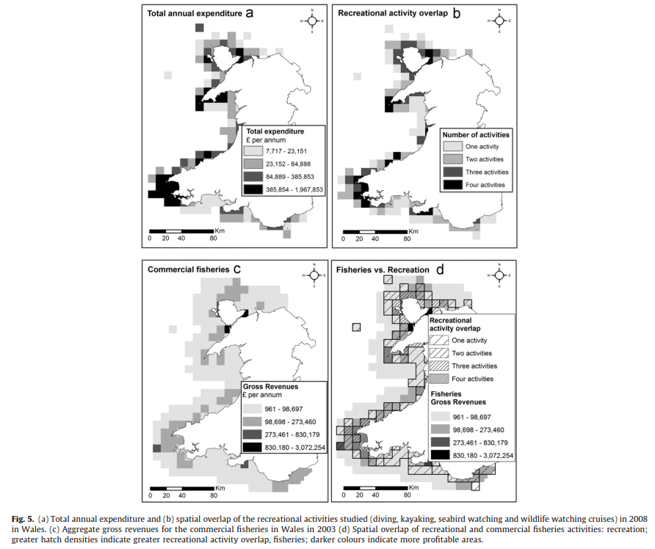
Examples of Outputs

Slide 8
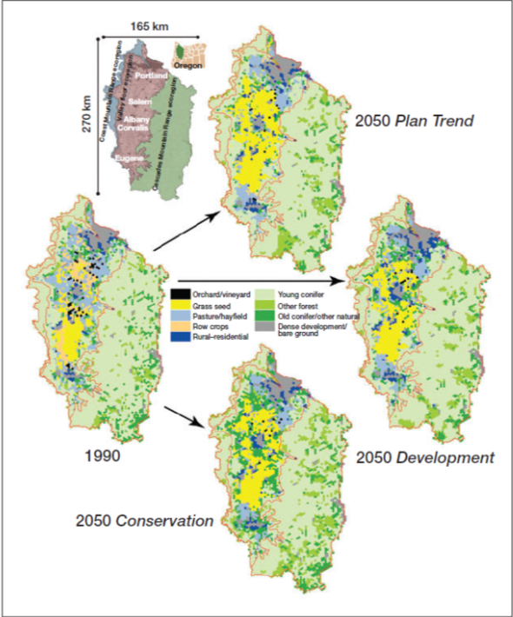
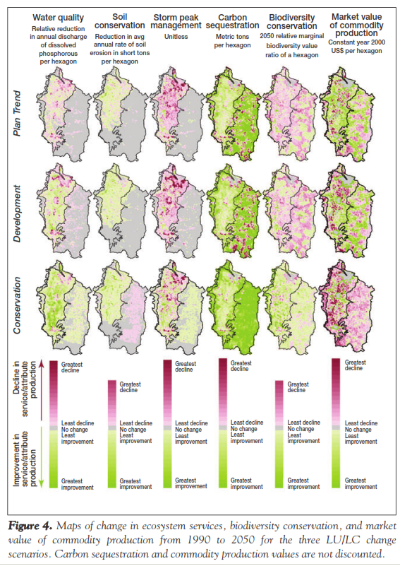
Examples of Outputs
Erik Nelson, et al. 2009. Modelling multiple ecosystem services, biodiversity conservation, commodity production, and trade-offs at landscape scales. Frontiers in Ecology and the Environment 7: 4–11
Notes:
So here, the investigators have used InVEST software to predict changes in ecosystem service, biodiversity conservation and commodity production levels. Using stake-holder defined scenarios of land-use to land-cover change.
Initially they have mapped the landuse and land cover of their study area at 500 hectare hexagon resolution.
Then looked at the 3 scenarios:
Plan trend: the expected future landscape – should current policies be implemented and recent trends continue
Development: where there is a loosening of current policies to allow development across the landscape but within plausible limits
Conservation scenario: which places greater emphasis on ecosystem protection and restoration, but still reflects a plausible balance and scenario.
Running the Invest model you’re able to see the changes to each ecosystem service the occurs under each scenario.

Slide 9
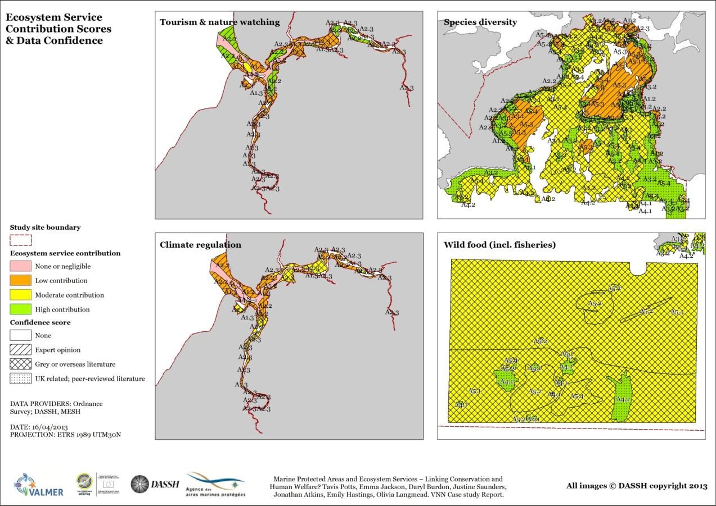
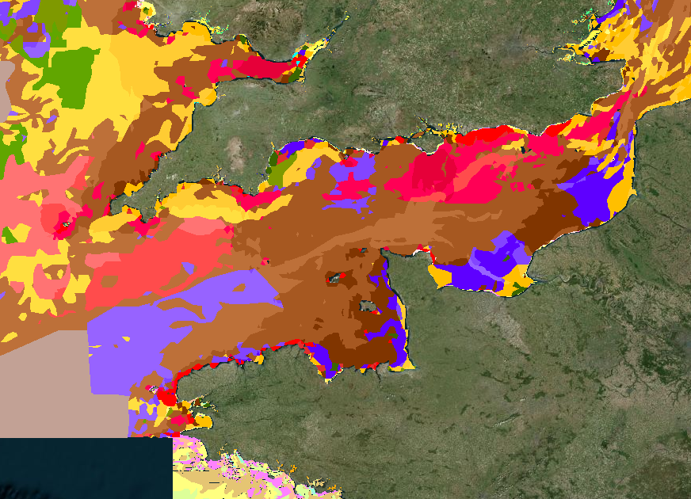
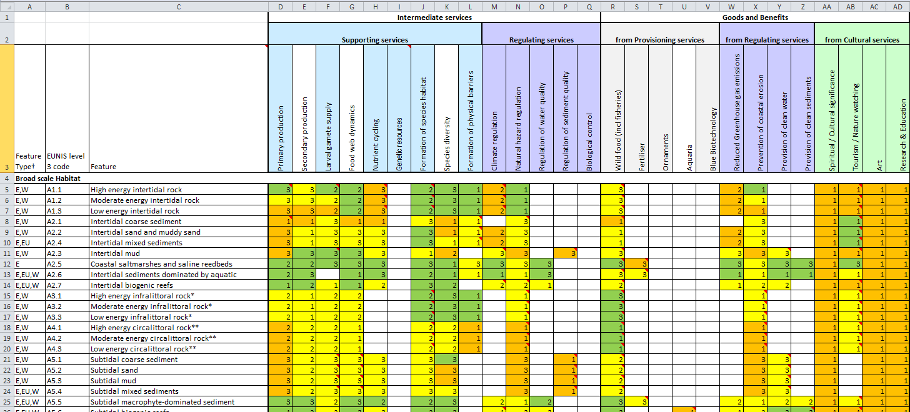
Examples of Outputs
Potts et al (current) Marine Protected Areas and Ecosystem Services - Linking Conservation and Human Welfare? VNN Case Study Report.
Notes:
The colour relates to the significance of the contribution of a habitat to an ecosystem service where green is highly significant contribution then moderate, low and none or negligible towards red.
The number relates to the confidence in the data used to come up with these significance scores. Where 3 is regionally focused peer-reviewed literature; 2 is grey or overseas literature and 1 is expert opinion.
How can we map the contribution of that habitat AND the confidence we have in the data telling us that contribution? We need habitat polygon data, which we know is available at a fair enough scale through MESH – Mapping European Seabed Habitats.

Slide 10
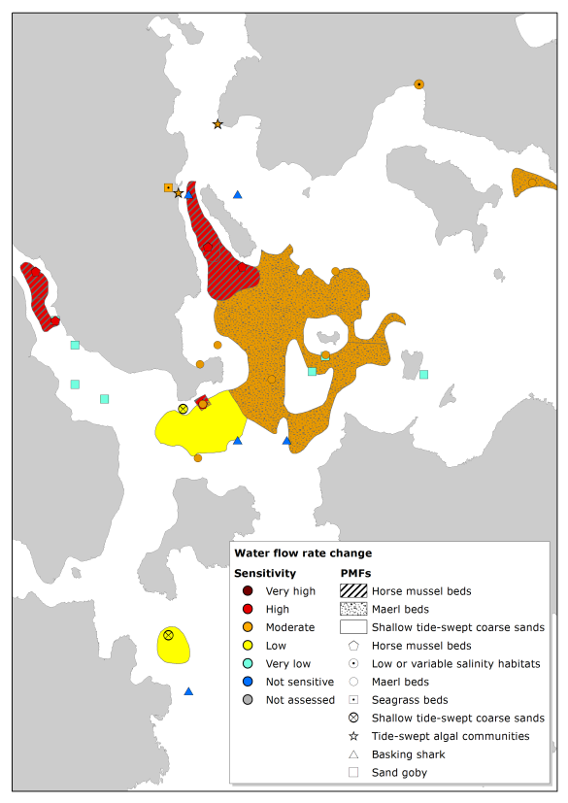
Examples of Outputs
Visualising sensitivity
Example: Fin fish farm and habitats vulnerable
to water flow rate
Notes:
The colour relates to the significance of the contribution of a habitat to an ecosystem service where green is highly significant contribution then moderate, low and none or negligible towards red.
The number relates to the confidence in the data used to come up with these significance scores. Where 3 is regionally focused peer-reviewed literature; 2 is grey or overseas literature and 1 is expert opinion.
How can we map the contribution of that habitat AND the confidence we have in the data telling us that contribution? We need habitat polygon data, which we know is available at a fair enough scale through MESH – Mapping European Seabed Habitats.

Slide 11
In Summary
We can map the marine environment in a variety of ways
We can understand confidence & effort
We can look at change through time and under different scenarios
Build a picture of sensitivity and vulnerability

